Slide 1


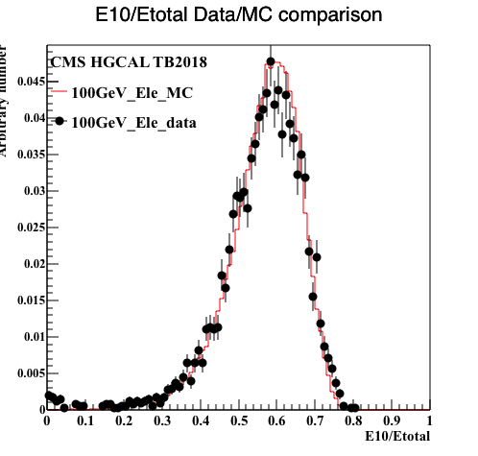







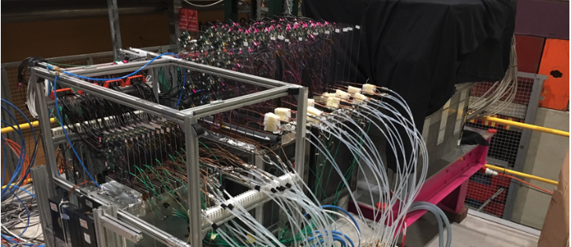
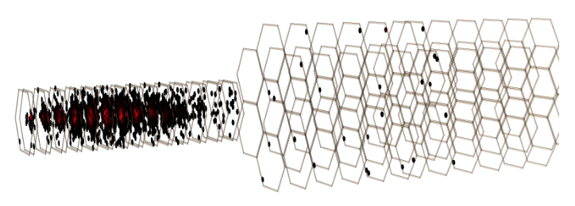
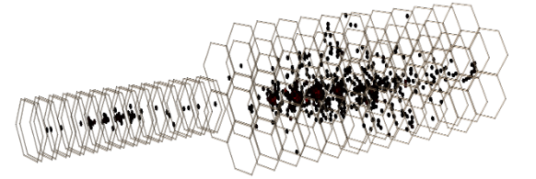
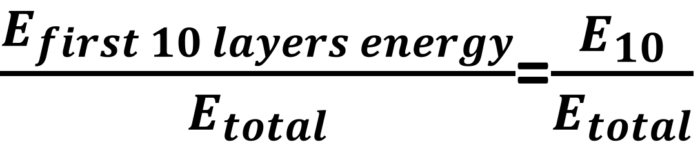




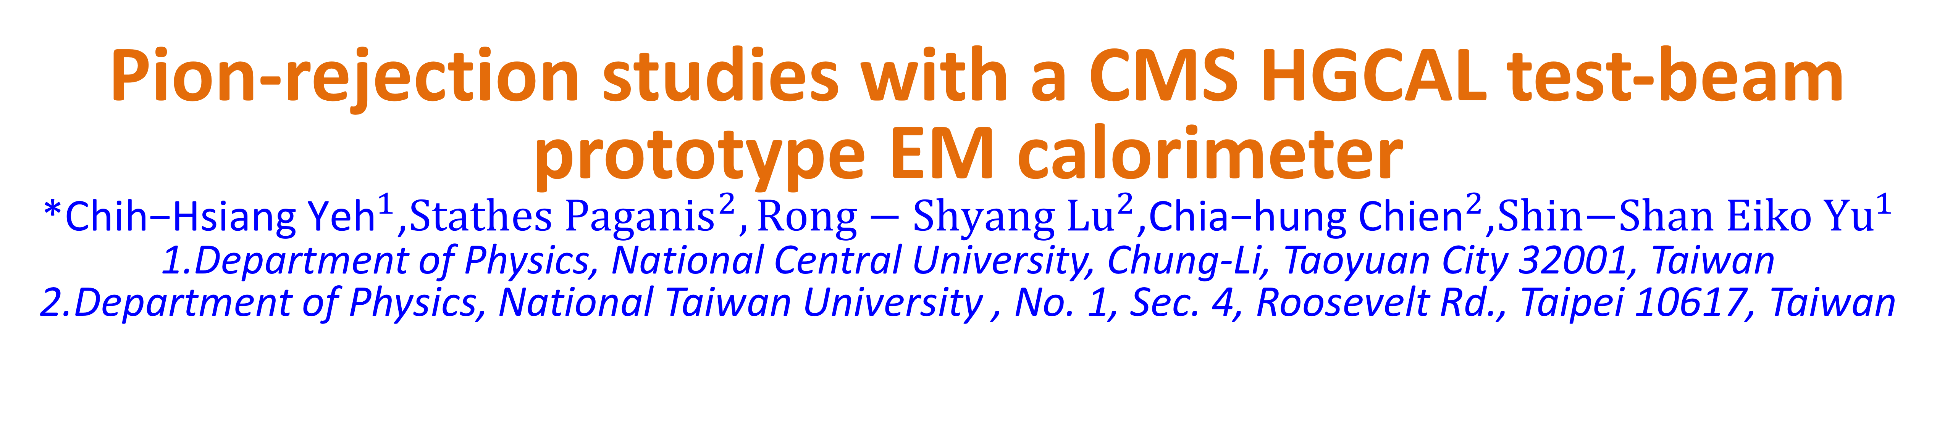
Pion-rejection studies with a CMS HGCAL test-beam prototype EM calorimeter
*${\text{Chih}\text{−}\text{Hsiang} \text{Yeh}}^{1}$,${Stathes Paganis}^{2},{Rong−Shyang Lu}^{2}$,${\text{Chia}\text{−}\text{hung} \text{Chien}}^{2}$,${\text{Shin}\text{−}\text{Shan} \text{Eiko} \text{Y}u}^{1}$
1.Department of Physics, National Central University, Chung-Li, Taoyuan City 32001, Taiwan
2.Department of Physics, National Taiwan University , No. 1, Sec. 4, Roosevelt Rd., Taipei 10617, Taiwan
Introduction
The CMS experiment at LHC will replace the current Endcap calorimeter with a Si-pad High Granularity Calorimeter (HGCAL), a new generation state-of-the-art calorimeter, which can perform 3D imaging of the shower as well as provide ~30ps timing. Charged-pion tagging and rejection are one of the strong points of HGCAL. Traditionally the most powerful discriminants for pion rejection are lateral shower containment and longitudinal energy leakage in the back of the EM section of HGCAL. In this work we study the capability of HGCAL to tag pions that are fully EM-showering in the EM section and they pass the lateral containment and leakage from the back requirements. Our main result is that HGCAL can provide a powerful discrimination between such pions that start showering after traveling a distance as Minimum Ionizing Particles inside the calorimeter, and incident electrons. This discrimination is achieved by introducing simple longitudinal shower variables.
Discriminating variable
Discriminating variable
Event selections
First 10 layers energy
ECAL
EM Shower Containment Cuts
Energy Leakage to the Hadronic Calorimeter Cut
Total energy
a. [Energy in five rings/ Total energy] need to bigger than 99%
$\frac{E_{first 10 layers energy}}{E_{total}}$=$\frac{E_{10}}{E_{total}}$
/
b.
> 0.85
Motivation
Exploit the fine granularity of HGCAL to reject pions that shower fully EM:
(1)They cannot be removed by energy leaking in the HADRONIC calorimeter
(2)They cannot be separated by lateral shape variables.
Can we use the MC of electron and pion to “tag” some of these pions?
No more than 0.4% energy fraction in the Hadronic Part.
Data/MC comparison for $\frac{E_{10}}{E_{total}}$
After this selection, we can tag out “e-like pion”
e-like Pion
Results
There are two types of e-like pion:
Early EM showering:
Late EM showering :
First, after event selections, we we get background rejection is 3601, which reject the ”real pion”.
Second, We use $\frac{E_{10}}{E_{total}}$> 0.18,0.20,0.22 to reject Late EM showering, seeing how many e-like pion can be rejected, and the electron can be reserved.
$\frac{E_{10}}{E_{total}}$is similar to electrons, put most of energy in the front detector, can’t be distinguished from the electrons.
Conclusion
Energy deposit in the backward layers, can be distinguished by the variable we set, the number about $\frac{E_{10}}{E_{total}}$=0.18,0.20,0.22
After a tight electron selection, a further pion rejection of 1.5 can be achieved without loss of electron efficiency

